Slide 1
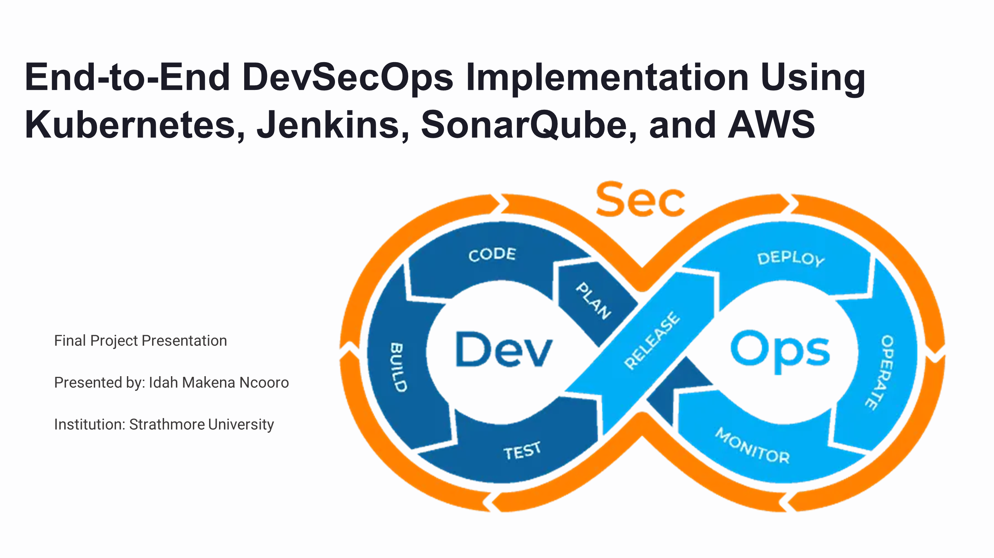

Slide 2

Project Overview
This project represents a comprehensive DevSecOps implementation showcasing industry best practices in continuous integration, deployment, testing, and monitoring. The solution features a secure, automated CI/CD pipeline for deploying a containerized web application.
The implementation integrates essential tools including Docker, Jenkins, SonarQube, Selenium, and Kubernetes, complemented by monitoring solutions such as Netdata and AWS CloudWatch. This end-to-end approach demonstrates practical DevSecOps workflows across both local and cloud environments.

Slide 3
Project Objectives
Automation & CI/CD
Quality & Testing
Security & Monitoring
Automate builds and deployments using Jenkins
Scan code quality using SonarQube
Monitor deployments using Netdata and CloudWatch
Perform UI testing using Selenium and Pytest
Deploy applications via Helm on Kubernetes
Ensure secure deployment with SSL certificates
Package applications using Docker and Nginx
Track development progress using Jira
Implement security headers for protection

Slide 4
Technology Stack
Development Tools
Backend/Infrastructure
VS Code: Primary code editor
Docker Desktop: Local Kubernetes support
PowerShell & Git Bash: CLI tools
AWS EKS & ECR: Cloud deployment
GitHub: Version control
Jenkins: CI/CD orchestration
Jira: Agile board and issue tracking
SonarQube: Static analysis (SAST)
Helm: Kubernetes packaging

Slide 5



Development Workflow
Frontend Development
Created React project using Vite, styled with TailwindCSS and shadcn/ui components, verified UI functionality
Containerization
Built Dockerfile with multi-stage build, configured Nginx to serve the app, optimized with .dockerignore
CI/CD Integration
Containerized Jenkins with required plugins, configured pipeline using Jenkinsfile, automated build/test triggers

Slide 6
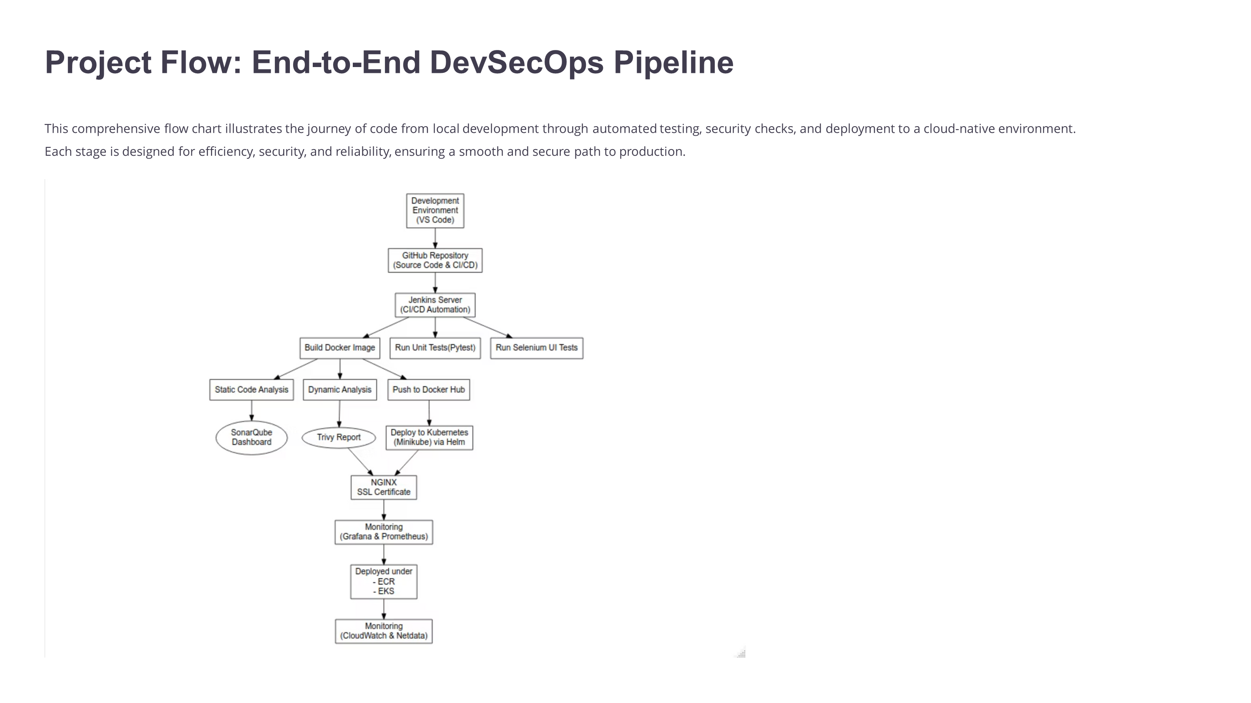

Slide 7

Quality Assurance & Testing
Code Quality with SonarQube
Set up SonarQube via Docker container
Configured sonar-project.properties
Integrated scans from Jenkins and manual execution
UI Testing with Selenium
Developed test_app.py using Selenium and Pytest
Tested title, heading, navbar, and button functionality
Automated screenshot capture on test failures
Generated comprehensive coverage reports

Slide 8
Kubernetes Deployment & Cloud Integration
Helm Chart Creation
AWS Cloud Deployment
Defined Helm charts for deployment and service configuration, set imagePullPolicy for local testing
Created EKS cluster using eksctl, pushed images to AWS ECR, configured kubeconfig context
1
2
3
Local Deployment
Deployed via Helm on Docker Desktop, validated service functionality via NodePort

Slide 9
Monitoring & Security Implementation
Monitoring Solutions
Security Measures
Initially attempted Prometheus and Grafana setup. Due to local configuration issues, successfully switched to Netdata via DaemonSet for local monitoring.
Configured SSL certificates (self-signed) in Nginx configuration for encrypted communications.
Added essential security headers including X-Content-Type-Options and X-Frame-Options for enhanced protection against common web vulnerabilities.
Integrated AWS CloudWatch during EKS deployment for comprehensive cloud monitoring and alerting capabilities.

Slide 10
Challenges & Solutions
Challenge
Solution
Prometheus setup failure
Switched to Netdata and CloudWatch for monitoring
Helm install error (file size)
Used .helmignore to exclude large files from deployment
AWS CLI authentication issue
Installed AWS CLI and configured proper IAM roles
Docker image not pulled correctly
Ensured correct tags and set imagePullPolicy: Never
Kubernetes TLS timeout
Restarted Docker Desktop and kubelet services

Slide 11
Project Results & Conclusion
Successful Implementation
Security & Monitoring
CI/CD integration with Jenkins
SSL enabled with security headers
Static analysis with SonarQube
Netdata (local) and CloudWatch (AWS) monitoring
Dockerized build with Nginx
Selenium test suite validation
Helm deployment to Kubernetes
Jira task tracking integration
This comprehensive DevSecOps project provided hands-on experience implementing modern software delivery pipelines. The integration of development, security, testing, and monitoring phases demonstrates the flexibility and power of containerized DevOps workflows across both local and cloud environments.

